Slide 1
Tips for Writing a Research Abstract and Creating a Research Poster LAsBEST@USC Summer Seminar June 30th, 2023
Elizabeth Burner MD MPH PhD

Slide 2
Goals for today
Tell you about my background and why I am interested in you!
Introduce you to some useful resources for:
Writing a successful scientific abstract
Developing a successful scientific poster
Go over some practical recommendations
Discuss roadblocks to creating research abstracts and posters

Slide 3
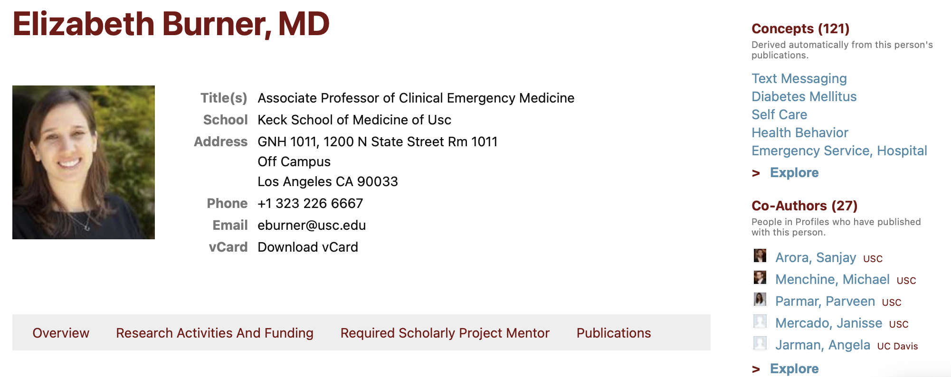
https://profiles.sc-ctsi.org/elizabeth.burner
Faculty Instructor
Clinical & Translational Research
Course Director, Introduction to Clinical & Translational Study Design
Research Interest
Emergency Care
Patient Interventions

Slide 4
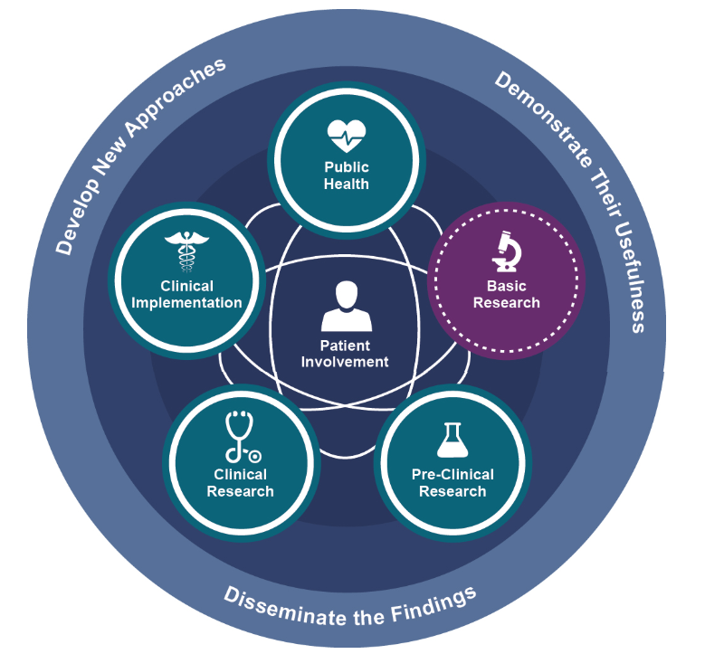
Clinical and Translational Research Paradigm
Impacto
▾Severidad
▾Internaciones
▾Costo
▾Mortalidad
▵Calidad de vida
https://ncats.nih.gov/translation/spectrum
Notes:
Explain the translational paradigm and our obligation to propogate translation.

Slide 5
Why I am Interested in You.....
I am interested in improving the health of humans by training researchers to conduct high quality, rigorous and reproducible research studies
High quality research has a better chance of improving the health of individuals
High quality reporting of research has a better chance of getting buy-in from the health community and thus getting translated to health care decision making.
As a researcher you will need to write research abstracts and present posters:
As part of a research training program
When presenting your research at a conference
When Applying for a grant
When Publishing
Thus, high quality reporting of research within the context of a research abstract and a poster are of key importance
The abstract and poster may be the only product that is read by the research community!

Slide 6
Research Abstract: Definition
It is an abbreviated and structured description of a research study
Short summary of the completed research

Slide 7
Have you ever written a Research Abstract?
What strategy did you use?

Slide 8
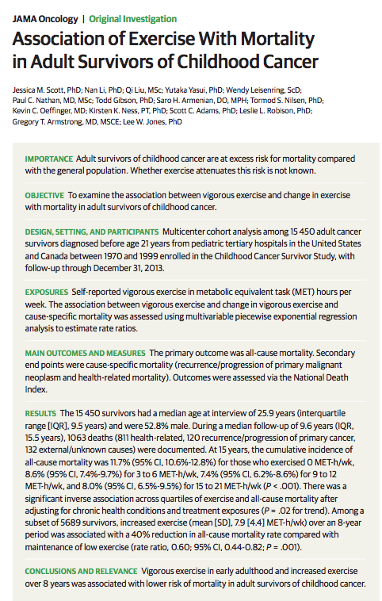
This is a study about the association between an exposure and an outcome.
What other types of studies are there?
The sections of the abstract can vary based on the study type.

Slide 9
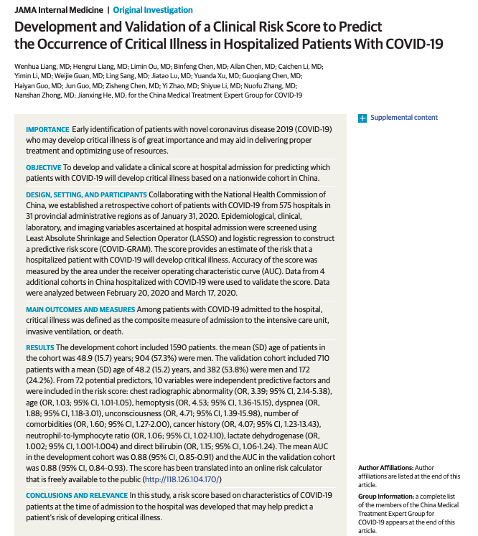

Slide 10
What other types of study designs are there?
Prediction Models
Association Models
The structure and information of an abstract will depend on the study design of the research.

Slide 11

A tool to help you write a rigorous abstract for your study.
https://www.equator-network.org/reporting-guidelines/

Slide 12

https://www.equator-network.org/reporting-guidelines/

Slide 13
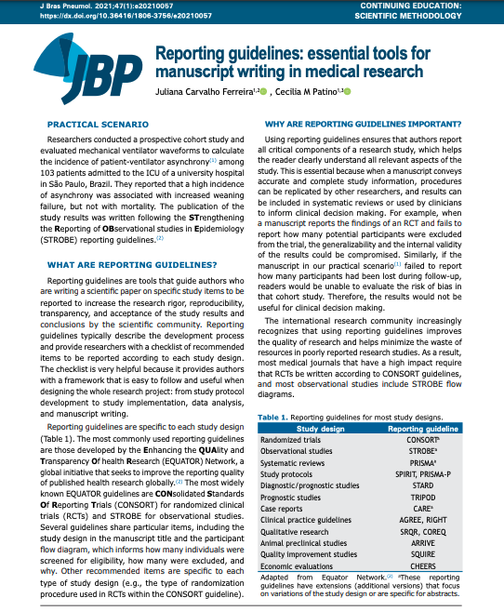
What is a reporting guideline?
It is a tool to guide a researcher on: -writing scientific papers
-lists items that should be included in each section of the paper
-including the ABSTRACT!!!
Items of a reporting guideline depend on the study design

Slide 14
https://www.equator-network.org/reporting-guidelines/

Slide 15
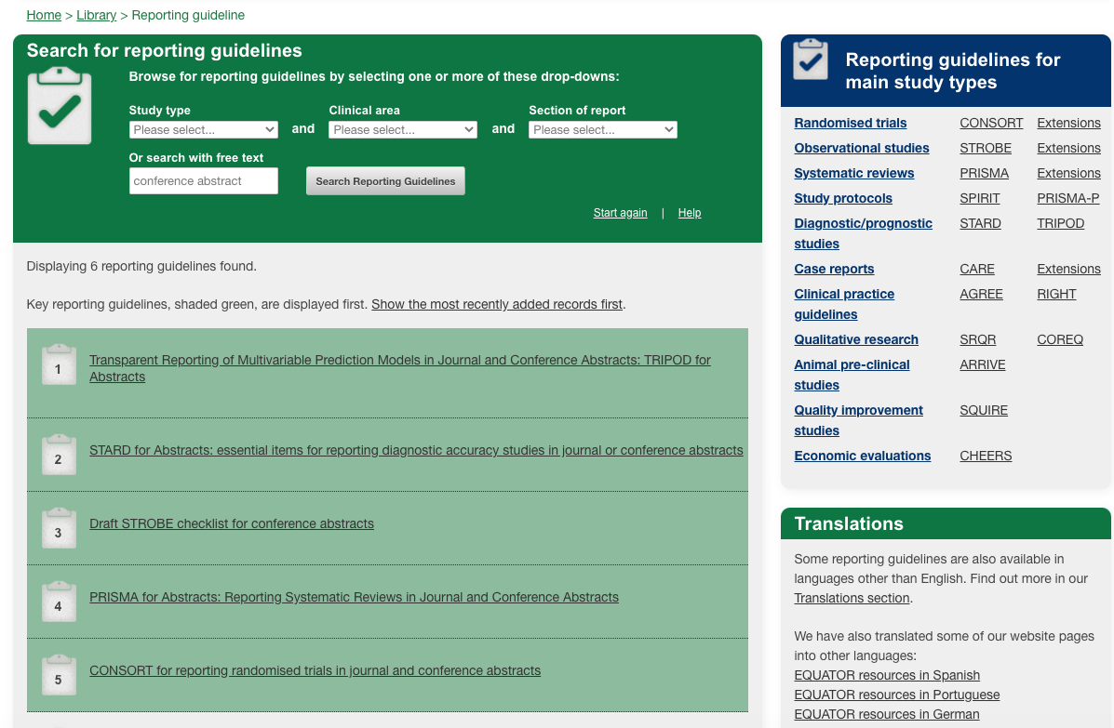

Slide 16

Association of Exercise With Mortality in Adult Survivors of Childhood Cancer

Slide 17
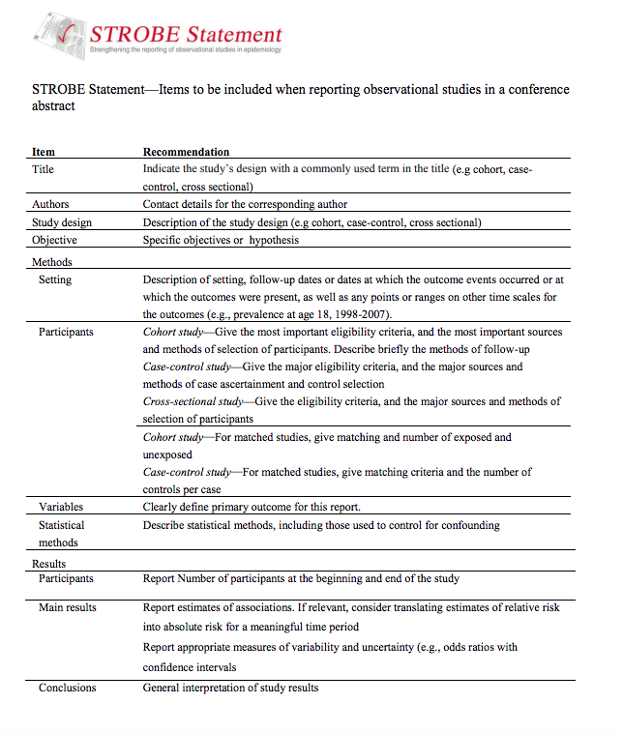
Link to reporting guideline

Slide 18
Abstract: Summary and Lessons Learned
Specific section that you need to write, and format according to the study design
There are very useful online resources that can guide you (EQUATOR network)
Title should ALWAYS! include the study design
Abstracts should catch your audience’s attention!
Using reporting guidelines makes the process of writing more efficient

Slide 19
Have you ever created and presented a Research Poster?
What strategy did you use?

Slide 20
Poster Presentation
These are the Goals of your program
Develop skills
Data management and exploration
Develop and implement a data analysis plan
Summarize the research results
Interpret the research results
Teamwork
Poster development and presentation
Summarize the setup of the study from which the dataset came from
Describe the methods used in analyzing the data
Describe the main findings from the analysis
Describe the conclusions drawn from the main findings

Slide 21
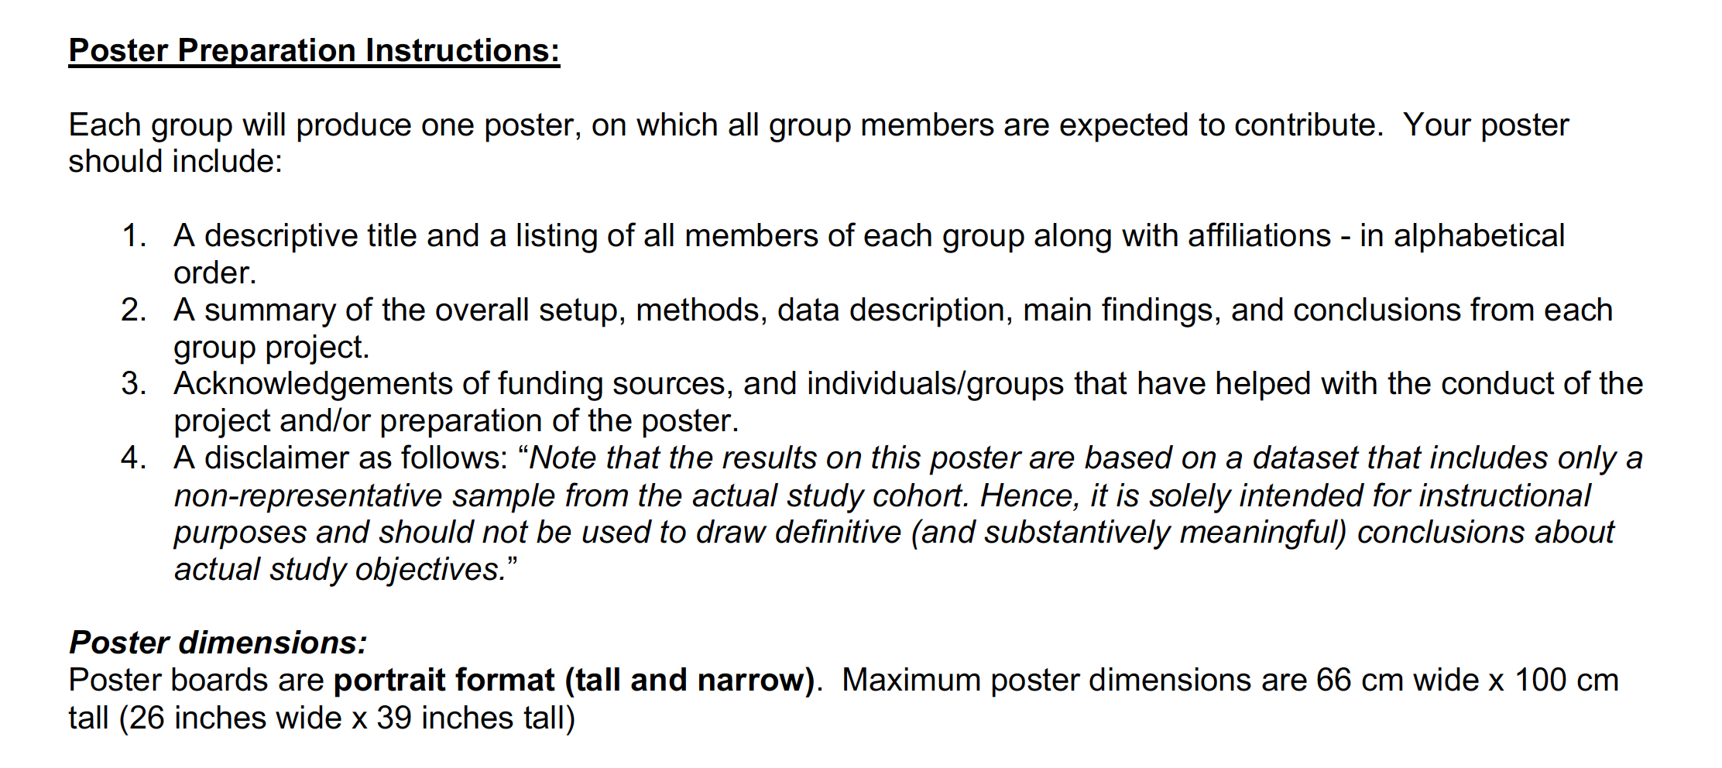
LA Best Poster Presentation Guidelines

Slide 22
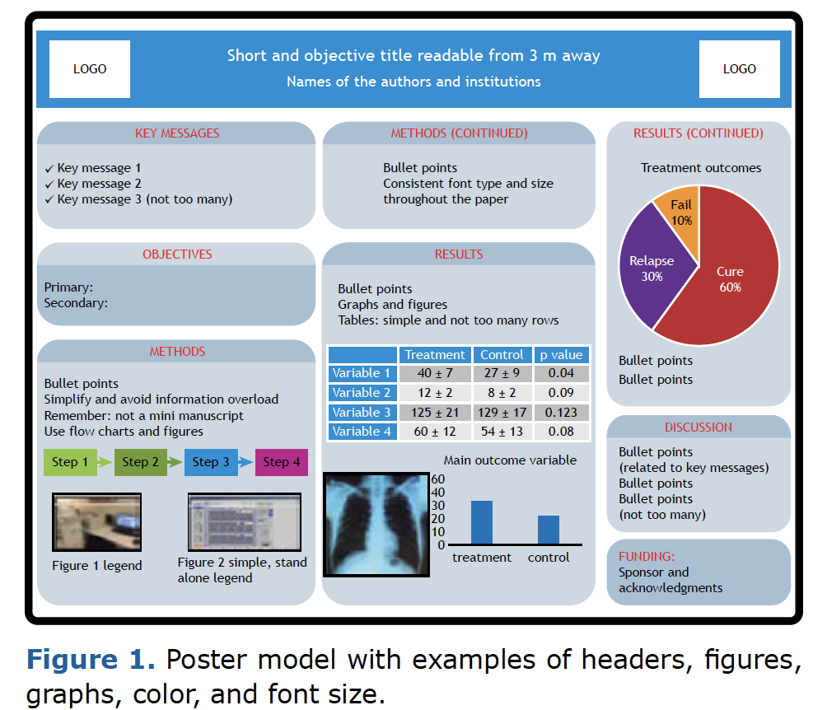

Example of a Poster Layout

Slide 23
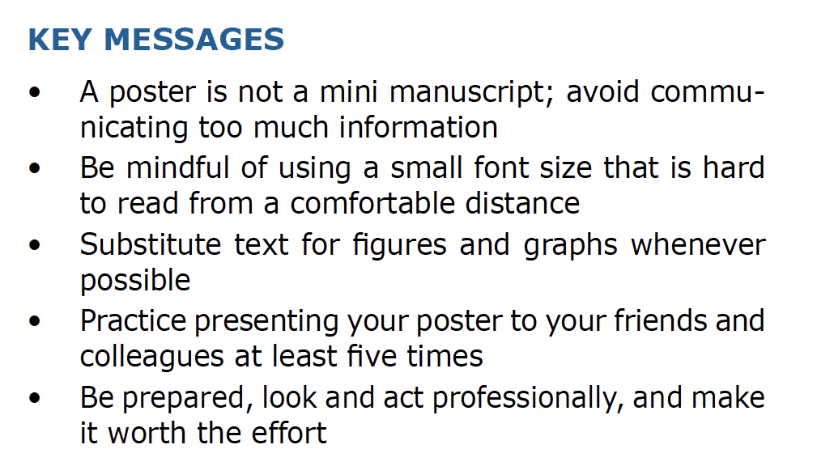

Slide 24
LAsBEST@USC Instructions
Provide Descriptive Statistics
summary statistics
visualization techniques
Fit regression models
Summarize findings using tabular and graphical displays
Provide interpretation of main findings and final models
Prepare poster summarizing
Goals
Methods
Main findings

Slide 25
General Poster Rules
3 min summary of your work
Visual appealing and clear
Repeat main points at least twice
QR code to your lab or personal website
May be viewed when you aren’t present
https://www.qr-code-generator.com

Slide 26
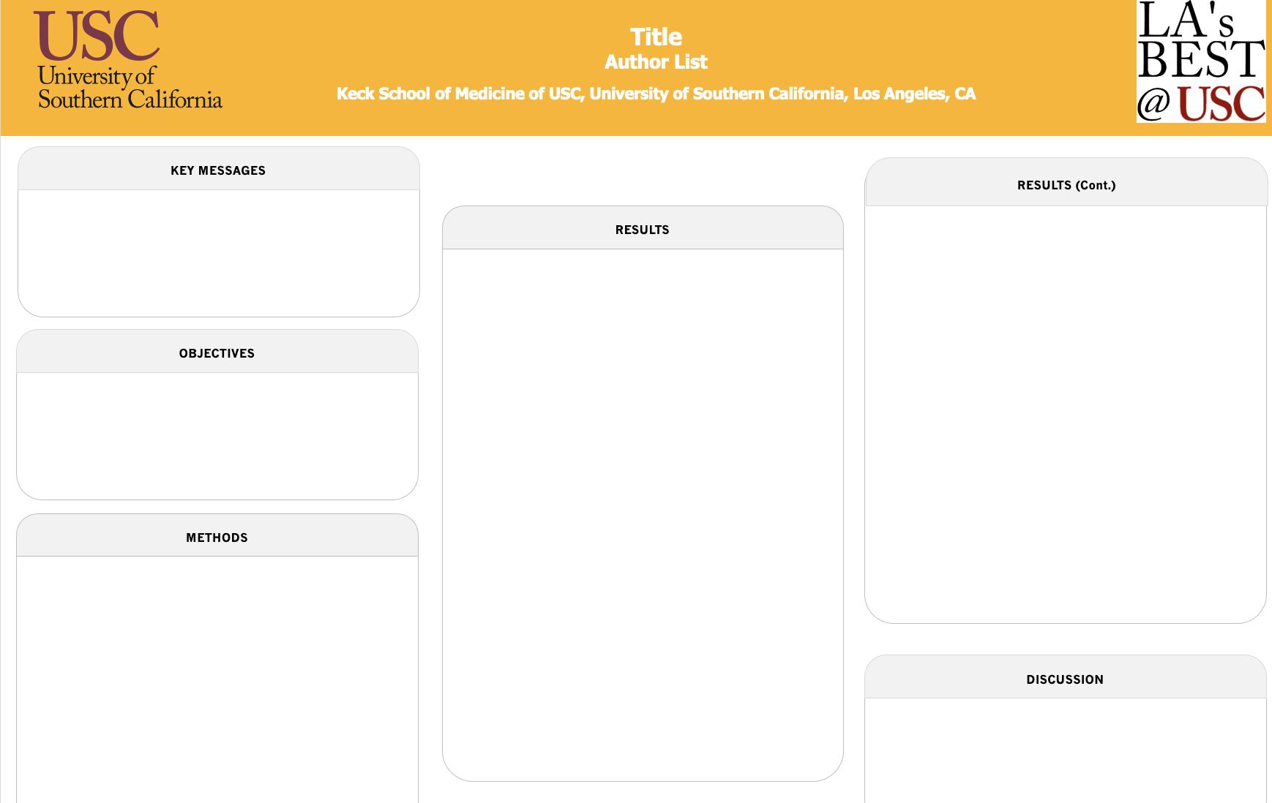
You have access to a template

Slide 27
Exercise: Outline your poster
Objectives:
What is the significance to health?
Why is your research question important?
What is your study’s hypothesis?
Methods:
How were participants selected? (Flow diagram, Figure 1)
How was the data collected?
What variables were collected?
Was the data transformed/changed for analysis?
What analysis methods did you use?
Results:
Table 1: Describe study population: characteristics important to understand the results? Are they different between exposure groups?
What are main results? (Table/Figure 2)
What other results are you presenting?
Discussion
What do these results mean compared to other studies?
What is new? Why might it be different?
What is similar? Does this build confidence?

Slide 28
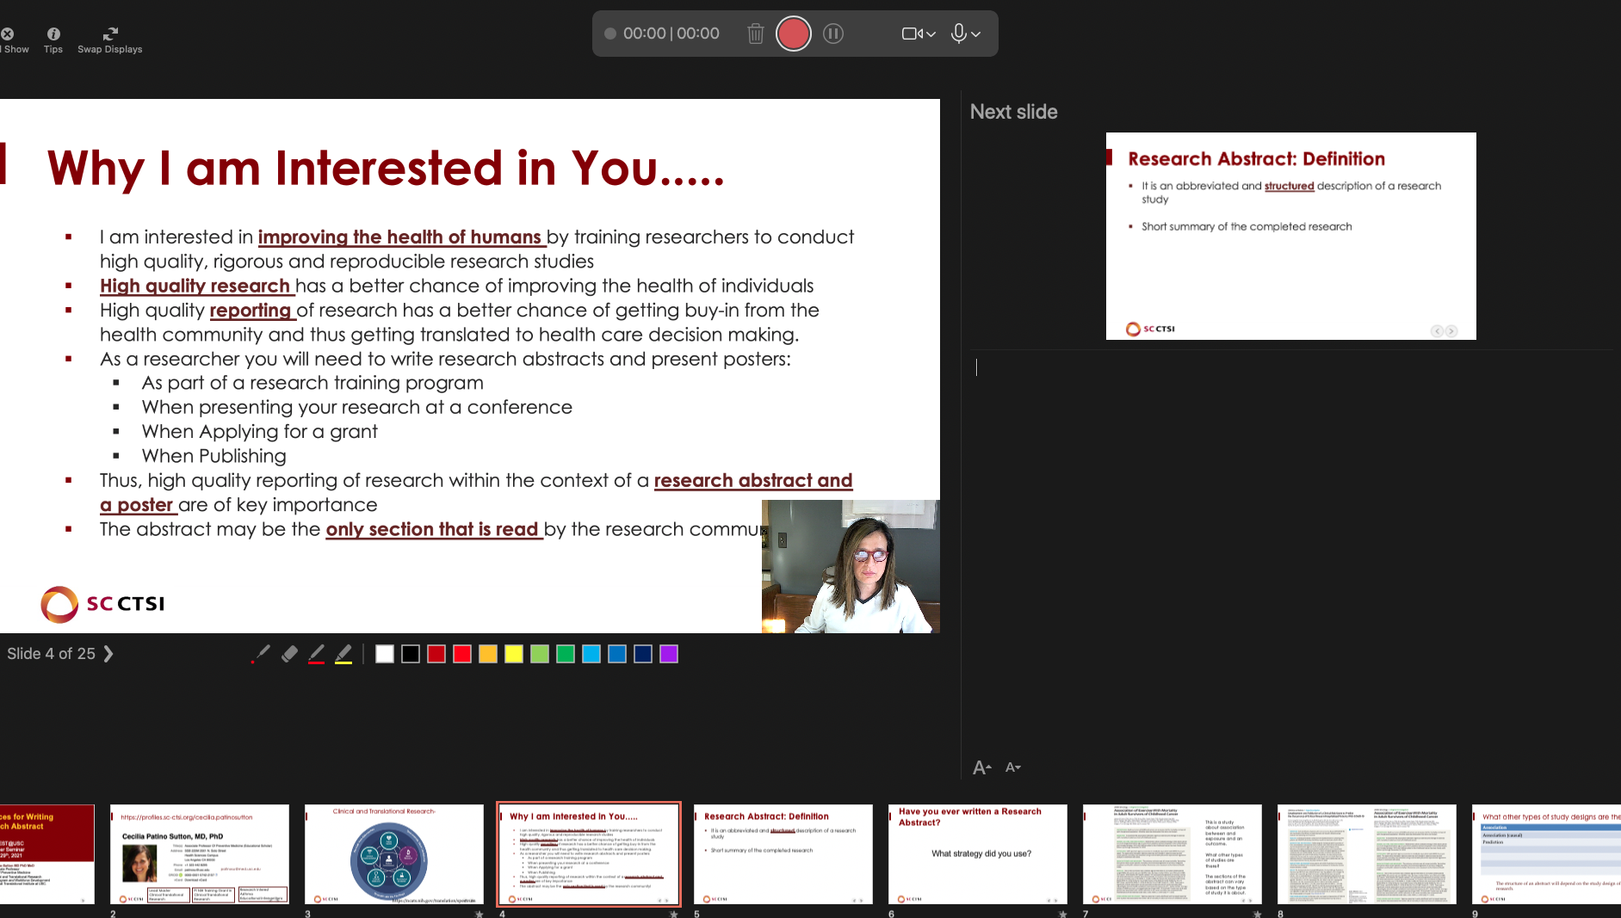
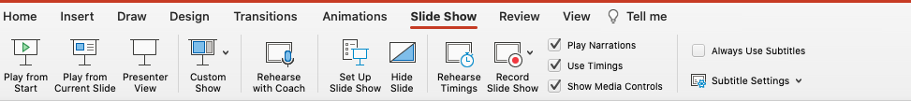
Preparing for the Oral Presentation
Decide what section each of you will present, but make sure you know all the sections
Write out what each one will say, every single word!
Practice presenting your section, many times
Use PowerPoint capabilities to practice
Record your presentation so you can evaluate and identify what sections to work on.
e.g., Write out what each one will say using
powerpoint recording capabilities.

Slide 29





General Presentation Principles
Communicate, Advertise, Discuss
Clear Research Question
Two Main Points
Graphical & Simple Colors
Rule of Six

Slide 30
Oral Presentations
Privilege: treat it so
5 – 10 min
3 take home messages
Visually appealing
Keep slides in your pocket

Slide 31
Dealing with Questions
Thank the “question asker”
Repeat the question
Be honest and open to critiques
Take notes

Slide 32
Exercise on Easy Graphics
First point
Second point
Third point
Fourth point
Step 1: Make a carefully edited list

Slide 33
Exercise on Easy Graphics
First point
Second point
Third point
Fourth point
Step 2: Convert to Smart Art

Slide 34
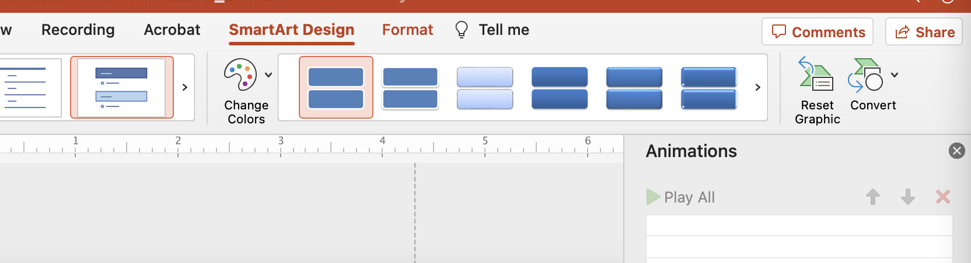
Exercise on Easy Graphics
First point
Second point
Third point
Fourth point
Step 3: Convert to Shapes & Ungroup

Slide 35
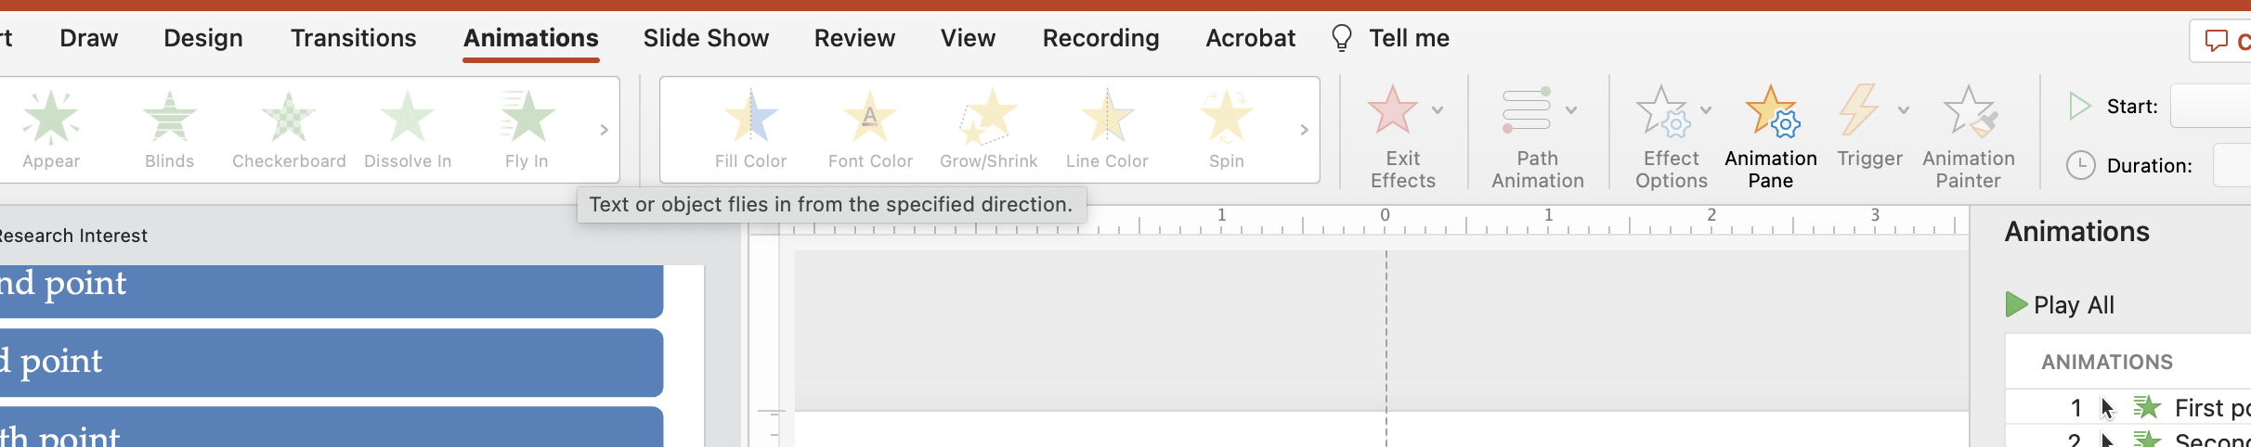
Exercise on Easy Graphics
First point
Second point
Third point
Fourth point
Step 4: Add Animation

Slide 36
Let’s summarize what we learned
Posters that are clear and concise do not intimidate the audience
Practice and write down every word you are going to say. PRACTICE!
Keep it easy to read, use graphs and tables, avoid word overload
Take advantage of Powerpoint capabilities

